Slide 1
Autonomous Robots
Traditional and Behavior Based Control

Slide 2
Traditional and Behavior Based Control
Path Planning provides a means to autonomously generate a path from a start to a goal
Requires complete knowledge of world and task
Replanning is needed if anything changes
Task-level control often has to consider more complex task conditions
Path planning would require very high-dimensional configuration spaces
Other approaches are needed to deal with unknown aspects of the task or environment

Slide 3
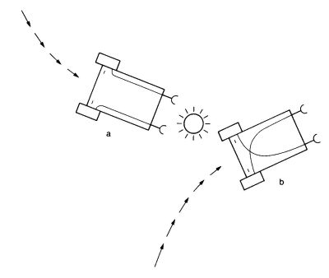
Cybernetics
Complex modeling and planning can solve complex tasks
Cybernetics – simple reactive sensor and control loops can “solve” complex tasks
E.g. Braitenberg’s vehicles
Simple vehicles with light sensors and motors
Control is direct mapping from sensors to actuators
Minimal logic is used to modulate reflexes

Slide 4
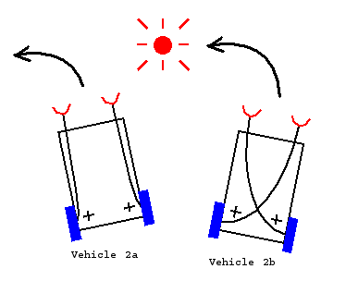
Braitenberg’s Vehicles
Faster if closer to light
Turns away from light and stops
“Coward” or “Fear”
Faster if closer to light
Turns towards the light
“Aggressive”
Simple vehicles by modulating sensor-motor loop

Slide 5
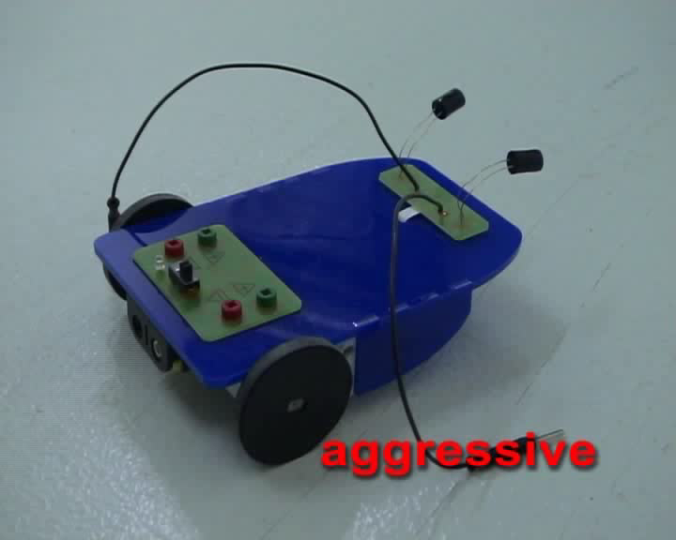
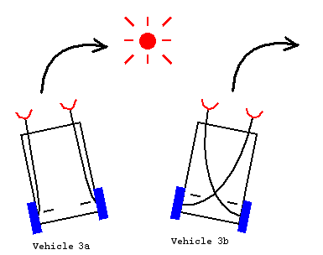
Braitenberg’s Vehicles
Slower if closer to light
Turns towards the light
“Love”
Slower if closer to light
Turns away from the light
“Explorer”
Simple vehicles by modulating sensor-motor loop
© F. Roth, J. Heinzle, A. Duff, J. Conradt

Slide 6
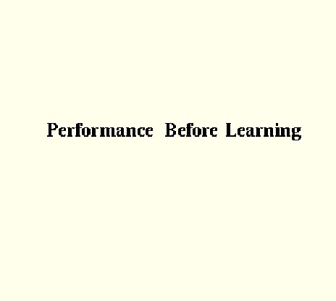
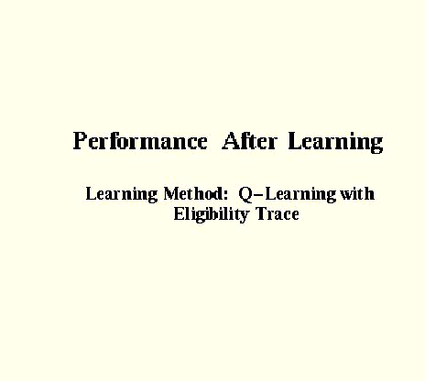
Cybernetics and Braitenberg’s Vehicles
Complex autonomous behavior can be built by from cybernetic reflexes or reactions
E.g. combining basic Braitenberg’s vehicles can address complex tasks
© E. Araujo

Slide 7
Autonomous Control Modes
Autonomous control architectures range in terms of the way they solve control problems
Reflexive Control
Direct stimulus-response mappings
No memory or map used
Reactive Control
Mapping from short-term local knowledge to control
Deliberative Control
Planning based on available information
Reflexive
Reactive
Deliberative

Slide 8
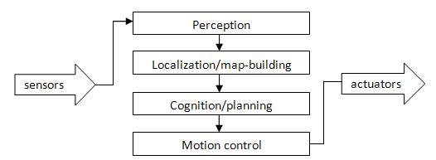
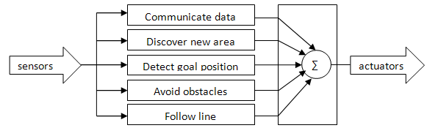
Reactive vs. Deliberative Control
Deliberative control uses a traditional sense, model, plan, execute cycle
Reactive control uses limited, distributed local models and distributed control
End-to-end tasks
Modeling bottleneck
Execution of solution
Fast reaction
Task solution unknown
Difficult for complex tasks

Slide 9
Deliberative Control
Deliberative autonomous control follows a sense, model, plan, execute cycle
Sensing: use sensors to observe the state of the Robot and of the environment
Modeling: Include the new information into a complete model of the Robot and the environment
Planning: Given the task goal, use a planning technique to come up with a solution plan
Executing: If a plan was found, perform the next step of the plan

Slide 10
Behavior-Based Control
Reflexes are direct mappings from sensors to motors
No models of the system or environment
No filtering and integration of sensor data
Reactive behaviors are more complex
Local, simple models
Accumulation, filtering, and integration of sensor data over time
Fast reactions based on the model

Slide 11
Reactive vs. Deliberative Control
Reflexive
Reactive
Deliberative
Reaction
speed
Model
dependence
Predictability
Robustness
Task
complexity

Slide 12
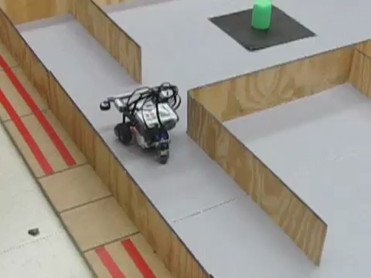

Behavior-Based Architectures
Behavior-based control can address situation without sufficient information
© Villanova ASV

Slide 13
Behavior-Based Architectures
Behavior-based systems combine a number of reactive behaviors
Composition combines the behaviors either in a competitive or a collaborative fashion
Behavior n
.
.
.
Sensors
Composition
Motors
Behavior 3
Behavior 2
Behavior 1

Slide 14
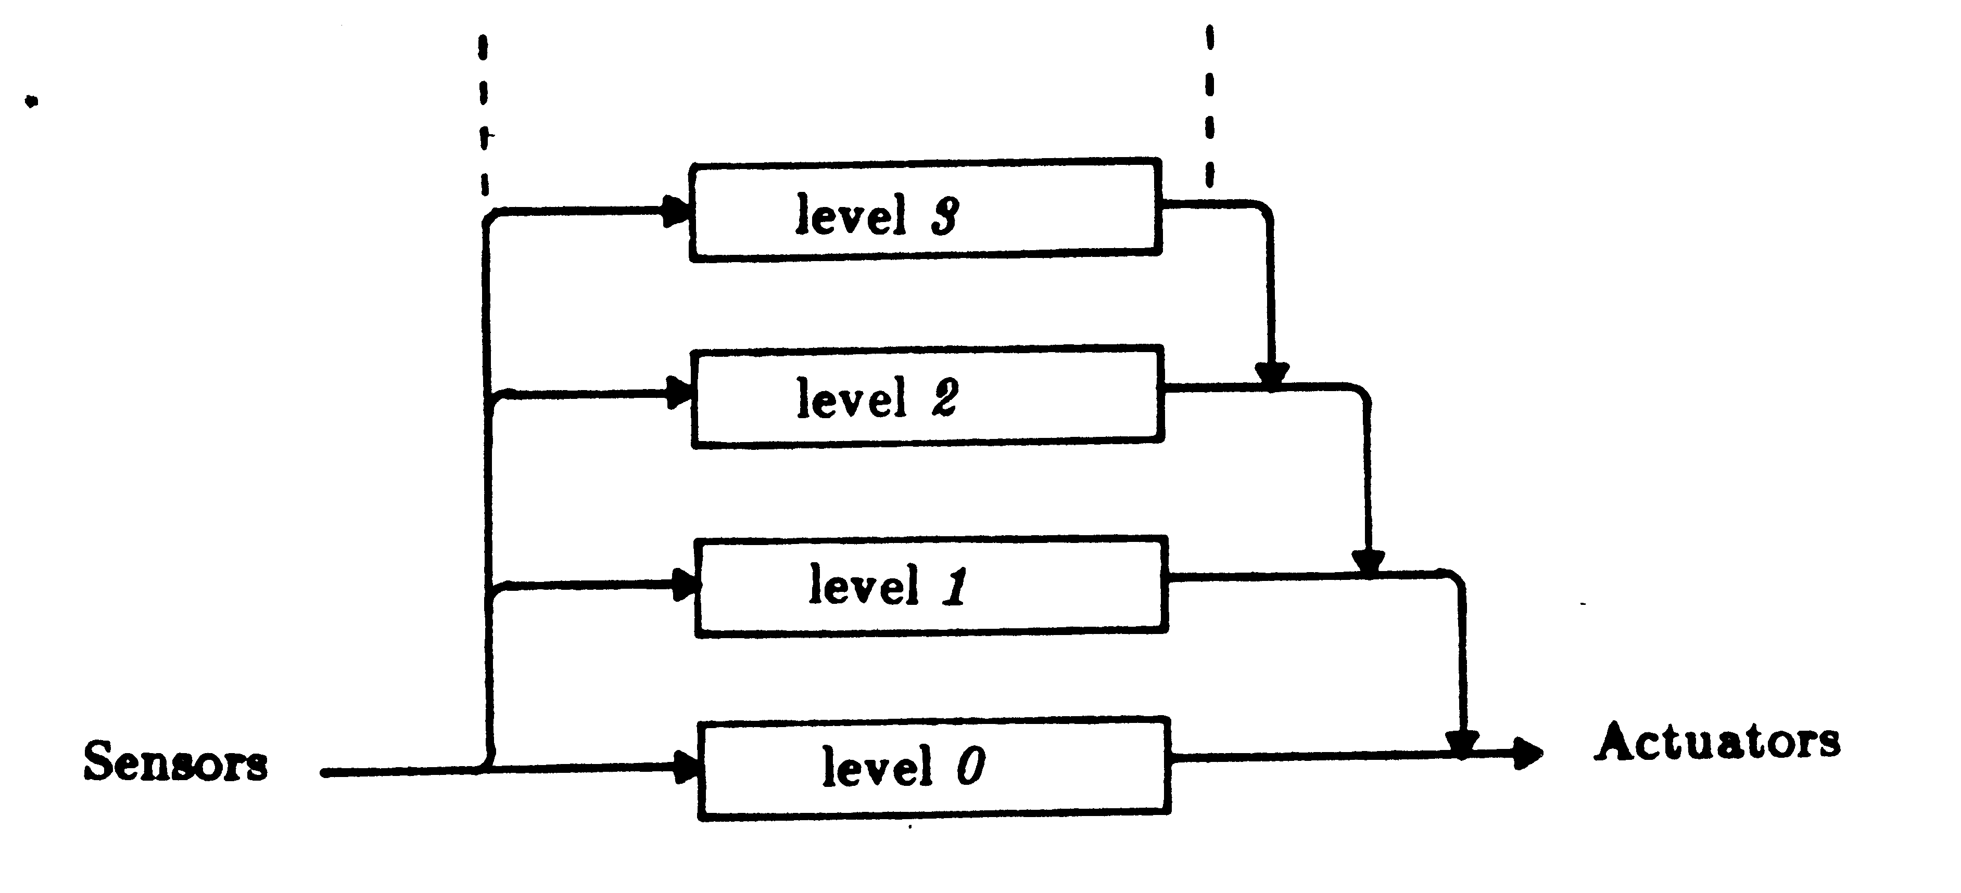
Behavior-Based Architectures
Competitive composition mechanisms
Priority-based – highest priority active behavior drives the system
E.g. subsumption
Strict priorities
Behavior proliferation
Easy to construct
Relative priority – dynamic priorities based on input determine winner
E.g. activation-based
Fewer behaviors
Harder to design
Behavior
Activation
Control

Slide 15

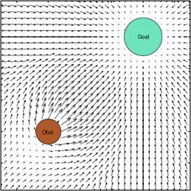

Behavior-Based Architectures
Cooperative composition mechanisms
Additive – All behaviors add together to drive system
E.g. schema-based
Emergent behavior
Fewer behaviors
Difficult to predict

Slide 16
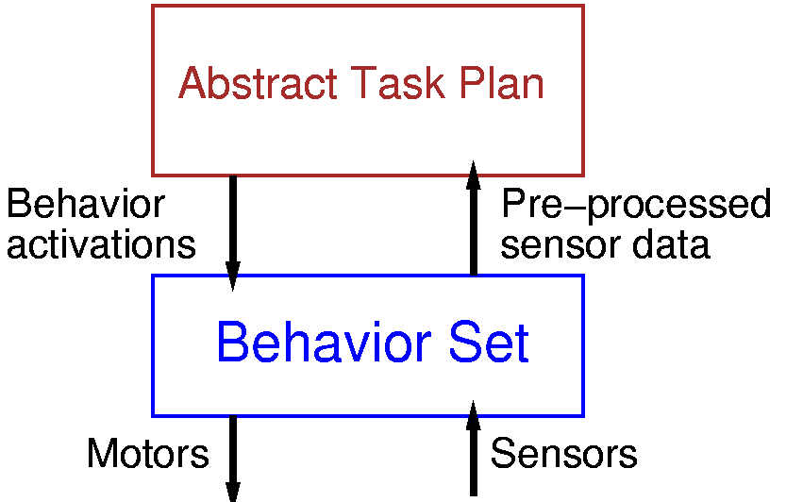
Hybrid Deliberative/Reactive Control
To get the best of both worlds, UxVs often combine deliberative and reactive control
Abstract task planning layer
Deliberative decisions
Plans goal directed policies based on environment models
Reactive behavior layer
Provides reactive actions
Handles sensors and actuators

Slide 17
Hybrid Deliberative / Reactive Control
Hybrid deliberative / reflexive architectures plan tasks at a more abstract level
Planning in terms of reactive behaviors
Allows to ignore details of the state during planning
Reduces the likelihood that the system deviates from the plan
Decomposes plans from low level aspects of the environment
Behavior layer operates system in environment
Fast reaction to changes
Bridges time needed to update plan

Slide 18
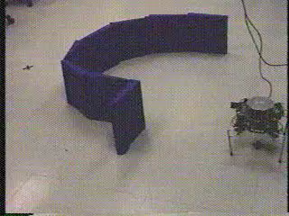
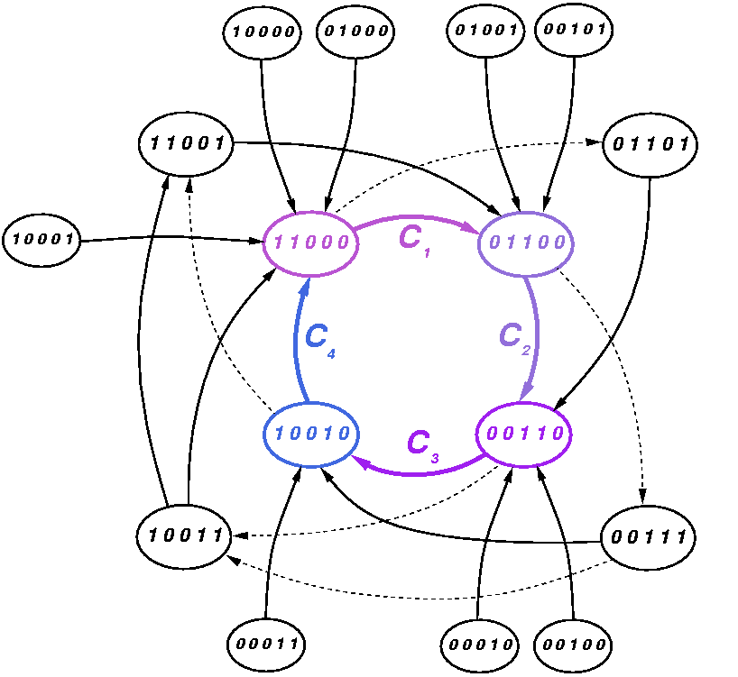

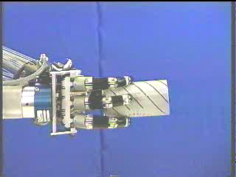
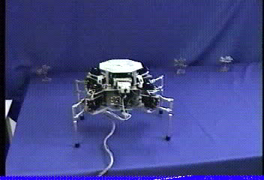
Hybrid Deliberative/Reactive Control
Hybrid architectures can yield autonomy at both the task and the local control level

Slide 19
Traditional and Behavior Based Control
Traditional control methods have a bottleneck in the form of a complete world model
E.g. Path planning requires complete world knowledge
Modifications to the model requires replanning
Very high overhead
No knowledge of correct activity during replanning
Behavior Based control attempts to solve tasks using a set of simpler controllers
Can be designed to react to unexpected situations
Have problems with complex tasks
Hybrid architectures can combine both

